Slide 1
Python Excel Automation
Shyam Bhagat

Slide 2
Selenium History
Developed in 2004 by Jason Huggins as a JavaScript library used to automate his manual testing routines
Selenium Core is born whose functionality underlies the Selenium RC (Remote Control) and Selenium IDE tools
The Limitation of having a JavaScript based automation engine and browser security restricted Selenium to specific functionality
Google, who has been a long time user of Selenium, had a developer named Simon Stewart who developed WebDriver. This tool circumvented Selenium’s JavaScript sandbox to allow it to communicate with the Browser and Operating System directly using native methods
In 2008, Selenium and WebDriver merged technologies and intellectual intelligence to provide the best possible test automation framework

Slide 3
What is Selenium?
Selenium is a suite of testing automation tools used for Web-Base applications: Selenium IDE, Selenium RC, Selenium WebDriver and Selenium Grid
Open source, web-based testing automation tool and cross-browser compliant, Muti-language backend support (Java, Ruby, Python, C#, PHP, ect…)
These tools provide a rich set of testing functions specifically geared to varied testing scenarios of all types of Web applications
The operations provided by these tools are highly flexible and afford many options for comparing UI elements to expected application behavior
Selenium tests can be executed on multiple browser platforms

Slide 4
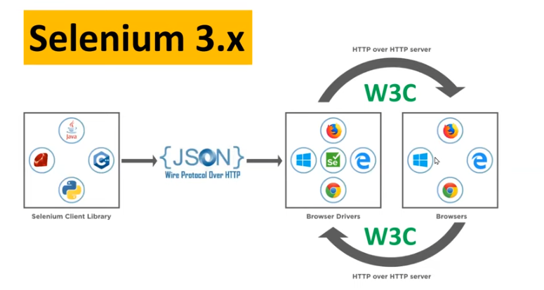
What is Selenium?

Slide 5
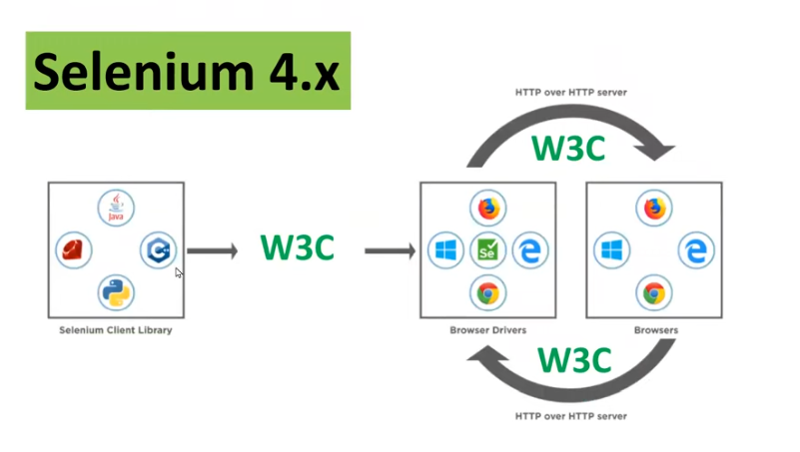
What is Selenium?

Slide 6


